Slide 1
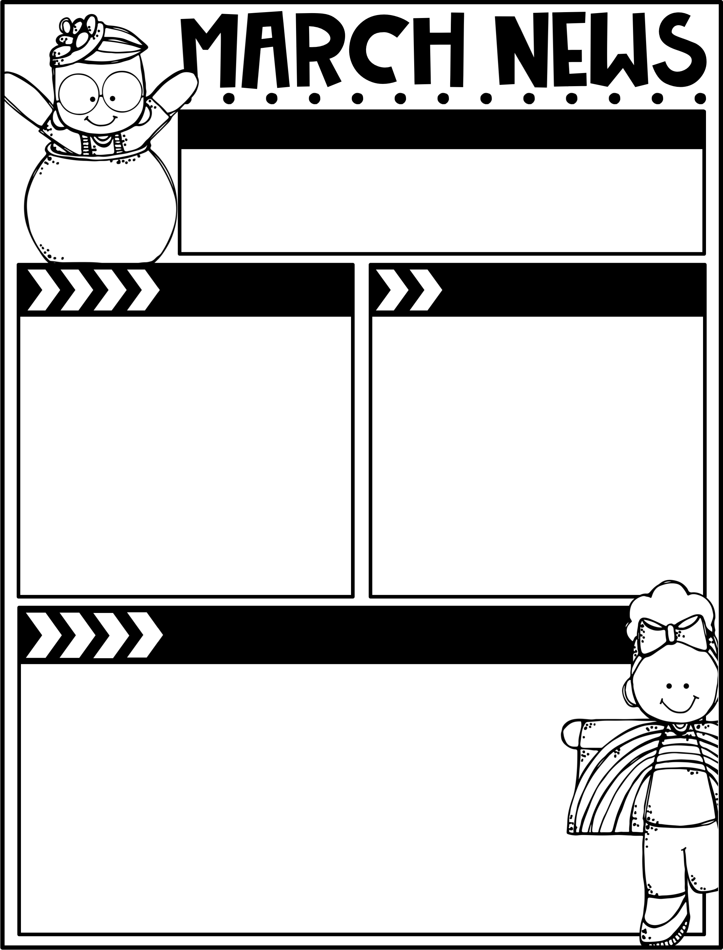
March 7, 2025
The Moreau Heights family is committed to providing a positive and safe learning environment to support responsible and productive citizens.
Phone:
573-659-3180
Plan Time:
1:35-2:25 pm
Emails:
mason.johnson@jcschools.us
danielle.mcgeorge@jcschools.us
theresa.schell@jcschools.us
Calendar
Learning Targets
M 03/10 A Day
Tu 03/11 B Day
W 03/12 C Day
Th 03/13 A Day
F 03/14 B Day, Library Check-Out
M 03/17 C Day
Tu 03/18 A Day
W 03/19 B Day
Th 03/20 C Day
F 03/21 A Day, Library Check-Out
March 24-28 No School, Spring Break!
Reading/Writing
I can identify the verbs in oral sentences, and indicate whether the verbs are in the present or past tense.
I can read a story and write a summary of the characters and key events in a text.
I can draft & edit a narrative ending.
Math
I can use compensation to subtract within 1000.
I can use compensation to keep a constant difference by subtracting he same amount from both numbers.
I can use concrete models to subtract & relate the to written recordings.
Social Studies
I can identify the difference between producers and consumers.
Things to Know
Specials Schedule:
Library Check-Out:
Second grade has check-out on Fridays! Please help your child remember their books!
SECOND STEP LESSON 20:
Be a Problem Solver
Summary
In this week’s lesson, your
child will be able to generate
possible solutions and select
the solution that makes
sense in a given problem.
Try This at Home
Ask your child to think of ways to solve
a problem.
 | Mr. J | Mrs. M | Ms. S
A | Music | PE | Art
B | PE | Art | Music
C | Art | Music | PE

